Slide 1

Agenda:
1- Revision on Binary Representation System
2- Bitwise Operations
3- Bit Masking
4- Iterative Search using Masks

Slide 2
Let’s Start!

Slide 3
01
Revision on Binary Representation System:

Slide 4
Binary Representation
X = 11010 = 26 = 2^1 + 2^3 + 2^4 = 2 + 8 + 16
X = 11010 = 26 // Last Bit shows Parity: Even / Odd
X = 11011 = 27
X % 2 = X & 1 = bit 0
Generally: X%(2^n) = X & (2^n -1)
Even test
if(n%2 == 1) -> Fails of n is negative
if( (n&1) == 1) -> Works always

Slide 5
02
Bitwise Operations:

Slide 6
Bitwise Operations
A B ~A A&B A|B A^B
0 0 1 0 0 0
0 1 1 0 1 1
1 0 0 0 1 1
1 1 0 1 1 0

Slide 7
X = 1152 = 10010000000
Y = 1428 = 10110010100
X & Y = 10010000000
X | Y = 10110010100
X ^ Y = 00100010100
A ^ B ^ C ^ D = E For any bit in E with 1, must be ODD number of 1s
X ^ 0 = X X ^ X = 0
(X) >> 1 = 1001000000 Equals X/2
(X) >> 2 = 100100000 Equals X/4
(X) << 1 = 100100000000 Equals X*2
(X) << 2 = 1001000000000 Equals X*4
(X) << 1 = 010010000000 Equals X*2

Slide 8
Problem: Problem - 579A - Codeforces Solution: Submission #250561389 - Codeforces

Slide 9
Problem: Problem - 1420B - Codeforces Solution: Submission #250563295 - Codeforces

Slide 10
03
Bit Masking:

Slide 11
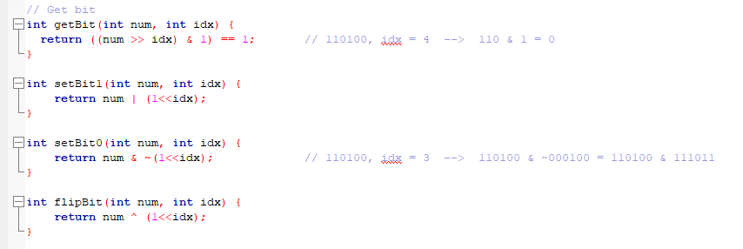

Slide 12
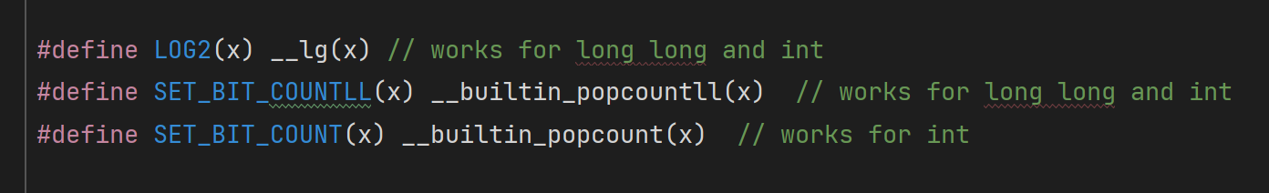

Slide 13
Be careful with operators' precedence problems. http://en.wikipedia.org/wiki/Operators_in_C_and_C%2B%2B#Operator_precedence
X & 7 == 1 is interpreted as X & (7 == 1) 🡪 (X & 7) == 1
1<<10 -1 is interpreted as = 1<<9 🡪 (1<<10) – 1
Watch out from overflow
1 << 60 Fails. 1 is 32 bitInteger 🡪 1LL << 60

Slide 14
04
Iterative Search using Masks:

Slide 15
Problem: Problem - 630K - Codeforces Solution: Submission #250565709 - Codeforces

